Slide 1
Python– Inheritance Type : Multiple PART - 3
In Tamil
By
Monisha S

Slide 2
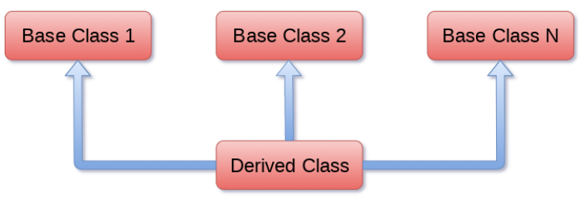
Multiple Inheritance
When a class can be derived from more than one base class this type of inheritance is called multiple inheritances. In multiple inheritances, all the features of the base classes are inherited into the derived class.
Syntax:
class Base1:
<class-suite>
class Base2:
<class-suite>
class derivedclass(Base1,Base2)
<class – suite>

